Slide 1
Scarab V4 HMI
Development Software Proposal
Santthos Siwasubramaniam

Slide 2

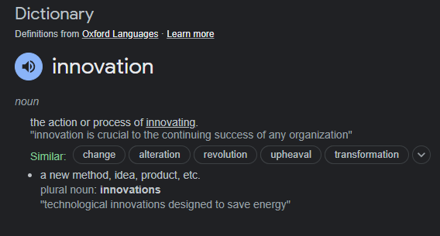
R&D…

Slide 3
01 – Research
02 - Solutions
03 – Qt
04 - System
05 - Demo
06 - Project
Overview
Market research into existing solutions, and their limitations.
What our options are with various software and methodologies.
An in-depth case study on the highest scoring solution.
Discussion on how our new HMI will be integrated into our control system.
An interactive demo developed using a trial license of Qt.
Cost analysis, project timeline and the bottom line…

Slide 4
Market Research and Demand
01
A study into the existing solutions and what the market demands are.
Let’s have a look at what is currently being done in the industry…

Slide 5
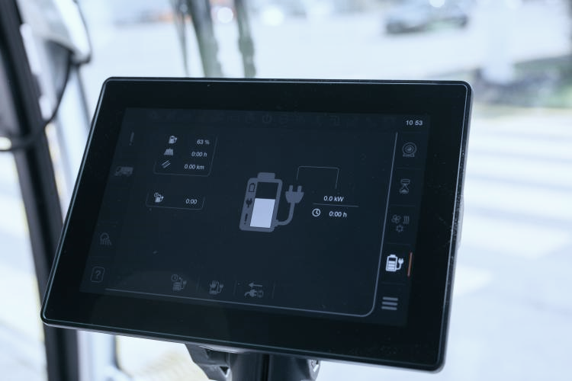

Csense touch-display
Fairly simple HMI design with interactable 2D graphics and some limited visual feedback but the 2D graphics are still better developed than what we have at the moment.

Slide 6
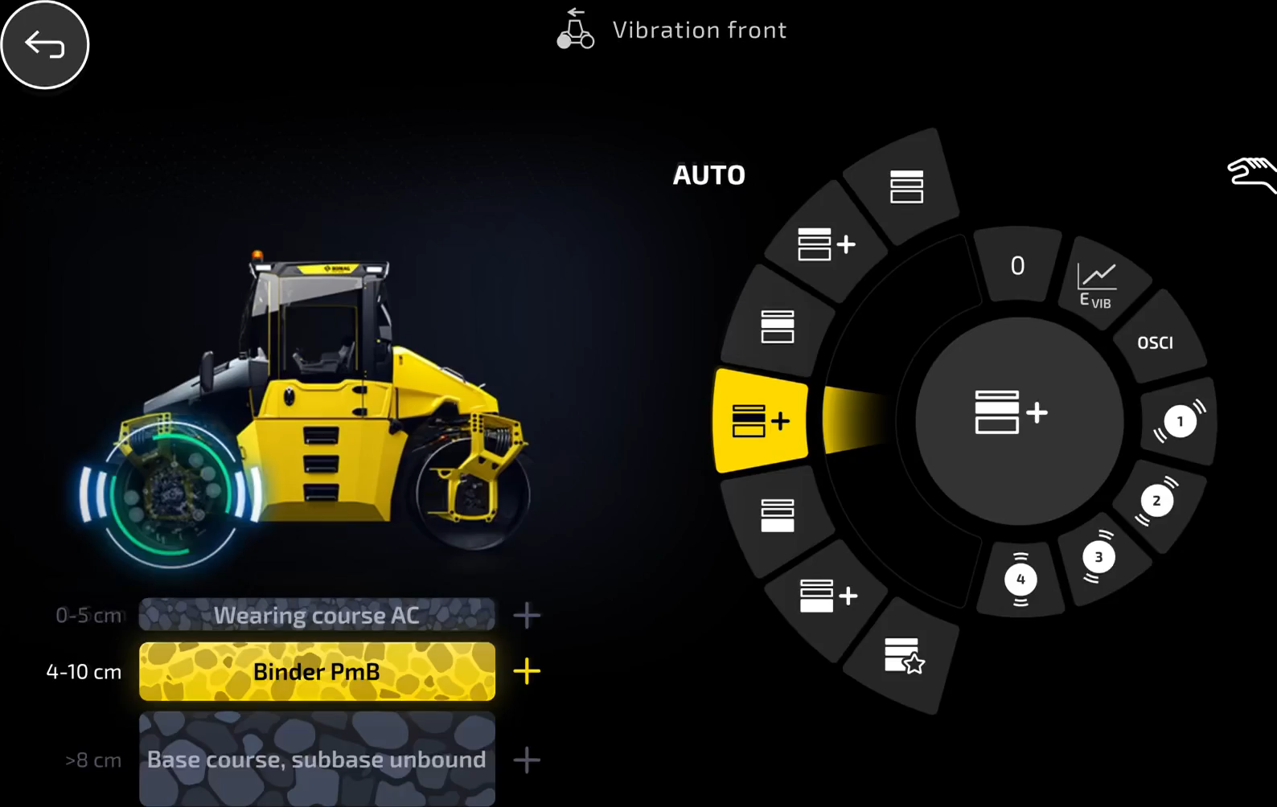

Modern, complex graphics
Intuitively designed to produce an easy to use efficient UI
Visual feedback on a 2D model of the machine

Slide 7
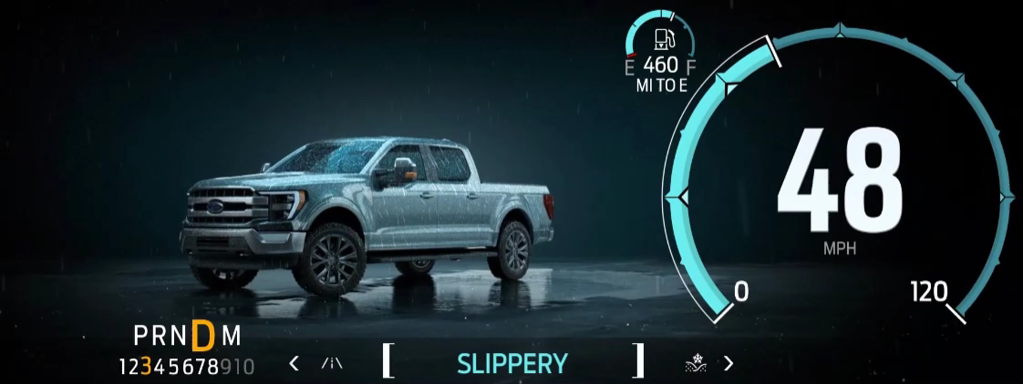

Slide 8
Our Market
Automotive
Industrial
The purpose of a HMI in the automotive industry is ultimately to allow a leisurely interaction by the user with their machine.
Tend to have minimalistic functionality in terms of operating the vehicle, and have a heavier focus on infotainment and overall aesthetic.
Modern, visually stunning and expensive.
HMI’S in industrial applications tend to be robust and clearly designed with functionality being its sole purpose.
Graphics are ussually very limited but there is a heavy focus on feedback data being presented to the operator.
Basic, feedback orientated, low-cost.

Slide 9

As with most things time passes and technology advances, while CODESYS remains a robust and powerful tool for control application development it has limitations in modern user interaction. Smooth animation and attractive UIs are difficult to create in CODESYS requiring far greater levels of engineering spend in order to develop graphical interfaces that a modern user expects and are comfortable with.

Slide 10
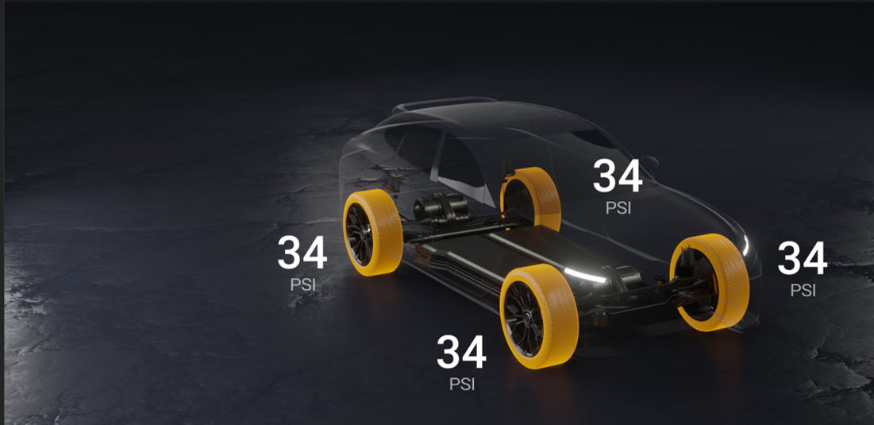
It’s time to move on.
Having already committed to a high-spec screen, we should really take advantage of its capabilities in terms of handling more complex graphics. The ceiling with CODESYS has been reached and if we stick with it, it stops us innovating more complex solutions into the future.

Slide 11
Our Software Options
02
An evaluation of various software packages and our selection criteria.
So what are our options and what can they deliver…

Slide 12






Development Software
Outsourced Development

Slide 13
The Options…
The Qt Company
An open-source games development platform which has recently expanded to allow HMI development.
The best option in terms of support, compatibility, cost and capability.
A similar software package to Qt but considerably more expensive and limited support – about a tenth the size of Qt.

Slide 14
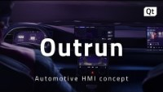
Mercedes, Hyundai, Koenigsegg, Harman, TomTom, Kia, Genesis, Rimac, Continental.
As posted by Qt on their youtube channel

Slide 15
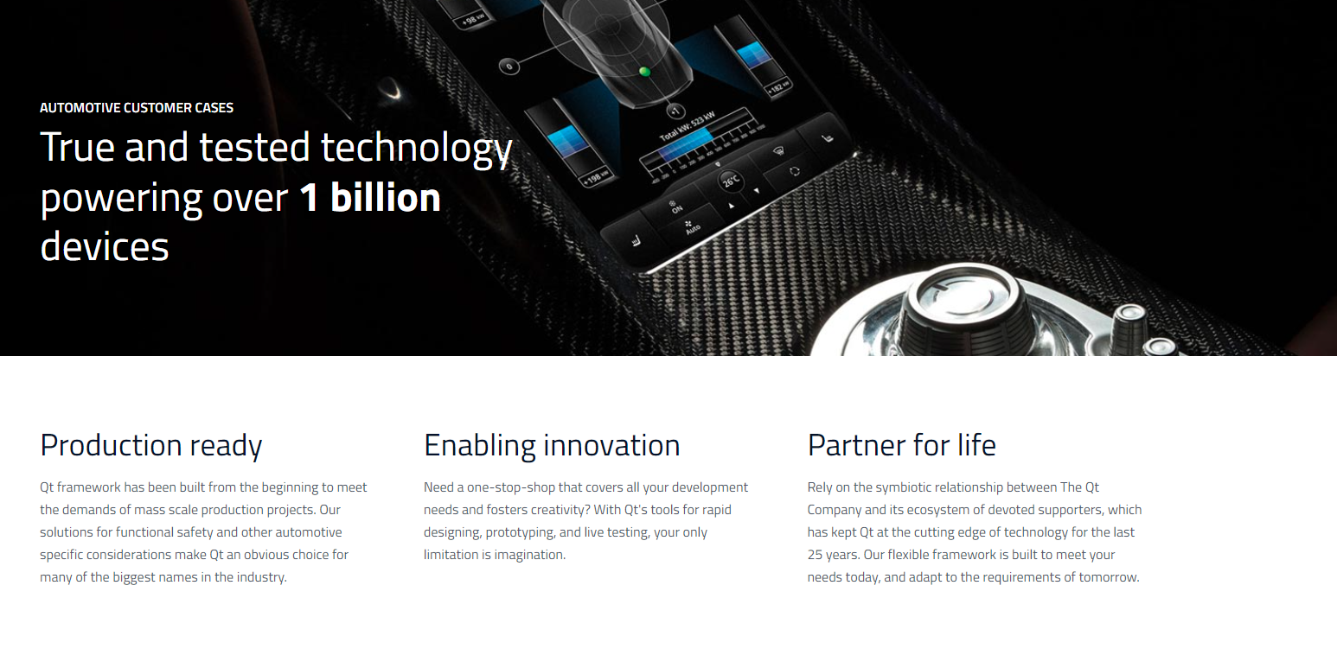

Slide 16
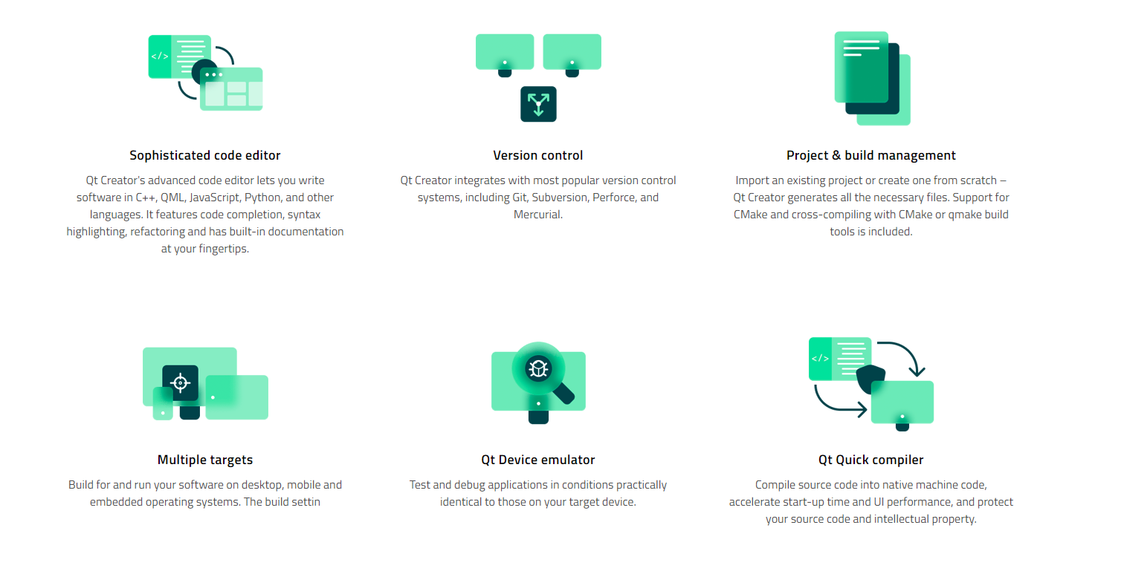
Did you know?
A man's best friend...
Mmm, can I fit in?...
Did you know that dogs can smell your feelings?
Dogs can pick up on subtle changes in your scent, which can help him figure out how you are feeling, such as by smelling your perspiration when you become nervous or fearful.
Did you know that a cat uses its whiskers as feelers to determine if a space is too small to squeeze through?
Also, cats love to sleep. A fifteen-year-old cat has probably spent ten years of its life sleeping.

Slide 17
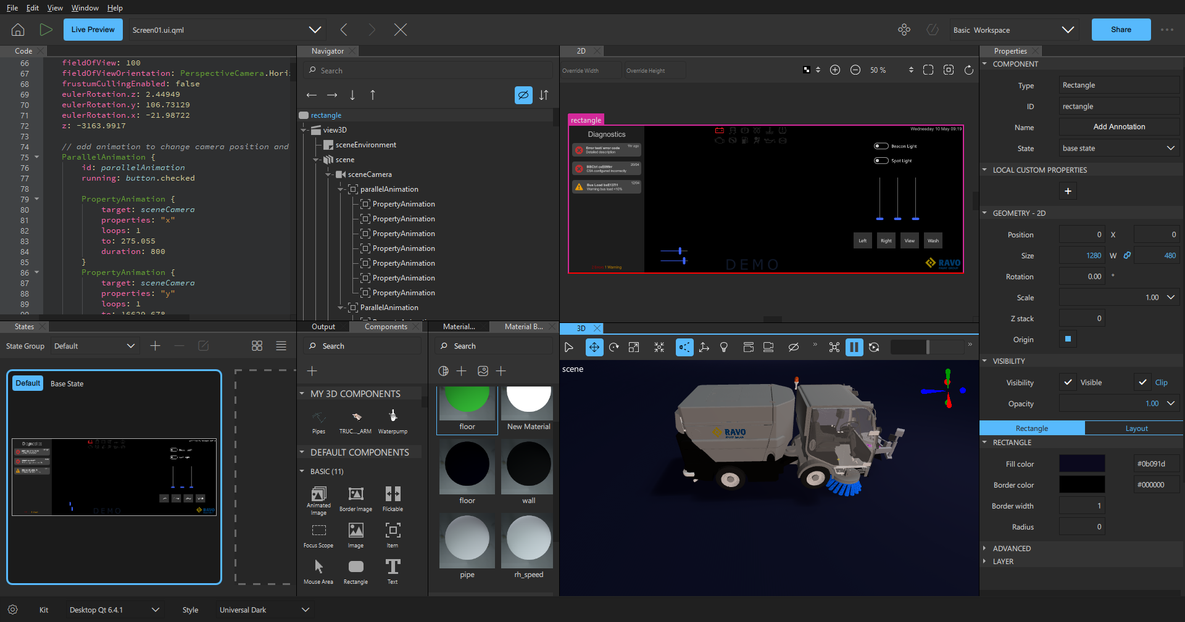

Slide 18
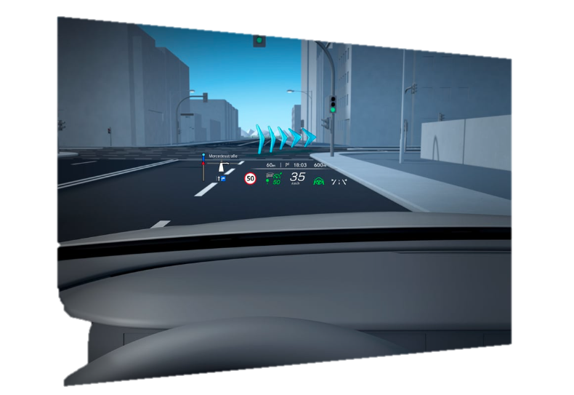
Fully data-driven 3D rendering engine
The Qt 3D Design Studio will allow us to implement ideas around augmented reality and mapping allowing us to offer much greater functionality to our customers.

Slide 19

Real-time feedback in a rich 3D environment
Feedback data from sensors along with forward control data can be represented on a 3D model of the truck in a set environment (as shown in the demo).

Slide 20

Driver Applications
Qt can compile cross platform to develop phone/desktop applications which will allow us to explore fleet management ideas for example.

Slide 21
System Integration
04
A review and evaluation of the challenges we face integrating a Qt application HMI with our back-end CODESYS control system
Has it been done before and how…

Slide 22
By combining CODESYS with Qt, system developers with existing CODESYS applications (and who are understandably hesitant to move to alternative tools and invest in building completely new applications) can take advantage of Qt’s strengths to deliver modern intuitive applications with minimal additional resources and reuse all of their CODESYS experience and resources.

Slide 23
Is it compatible?
Hardware – IFM CR1102 Display
Software – CODESYS & CAN Bus
Operating system: Embedded Linux 4.14
Processor: ARM Quad Core 64 Bit 1.2 GHz
Working memory: 1 GB RAM (can be a limiting factor for having complex detailed 3D renders 2GB recommended)
Mass Storage: 8 GB
Confirmed by ifm
Confirmed by Qt
SocketCAN – an API which provides CAN communication with a Qt application
Confirmed by Qt
Qt have significant experience developing applications which communicate via CAN so offer good support and assistance for setting this up.
Notes:
Ultimately the hardware we get from ifm is fairly high-spec, but they aren’t designed for highly graphically demanding applications as shown by the lack of a high-spec GPU. The GPU capabilities is something we need to test with Qt, i.e. load it with a complex 3D render of the truck with dynamic lighting and see if it handles it.
Ifm have confirmed that Qt has been used on their hardware before already and offer support in terms of deploying Qt applications on their hardware – however, this is fairly new to them and they are in the process of integrating better support for Qt clients.

Slide 24
Let’s see the
demo.
A pure ui.qml file with no real back-end logic developed using Qt evaluation license in 8 days.

Slide 25
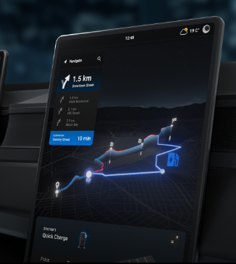
Ideas for future development…
V4
V6
V7+
Real-time 3D visual feedback – brush speeds, hopper movement, water jets, hydrostatic engaged…
Mobile/Desktop App for fleet management.
More sensors = more features, ultimately limitless but entirely dependent on sensors…
V5
Path mapping and integrated GPS
Notes:
V4 will be the big jump to the new software platform, and this I believe means we should prioritise aesthetics and focus on starting on the right foot in terms of appearance and the foundations of our functionality which is why I don’t want to over complicate features at this stage.

Slide 26
Cost Analysis and Project Timeline
06
Crunching the numbers and figuring out how this could fit into our V4 development timeline.
Is it too expensive and too time demanding…

Slide 27
Cost Analysis
£5242
£6.86
£3096
License per year
Distribution fee per device
Training cost per 8hrs for upto 8 people
Package Cost
*
£33.07/unit
(200/yr)
£17.34/unit
(500/yr)
License Cost/yr | £5241.77
Distribution License/2000 units | £13718.97
£18960.74
*Excluding training and labour cost

Slide 28
How long will development take?
6-8 month project*
Establishing CAN - API - HMI communication | 3-4 weeks
Transferring the existing interface functions | 3-5 weeks
Developing CAD files for renders | 4-5 weeks
Implementing kinematic motion | 1 week
Updating interface graphics/new graphics (2D) | 2-3 weeks
Developing new interface layout | 2-3 weeks
developing new features/transitions/animations (3D) | 6-8 weeks
Front end coding – HMI logic | 4-5 weeks
 | 25-34 weeks
*Dependent on 1 consistent developer full-time

Slide 29
The bottom
line…

Slide 30



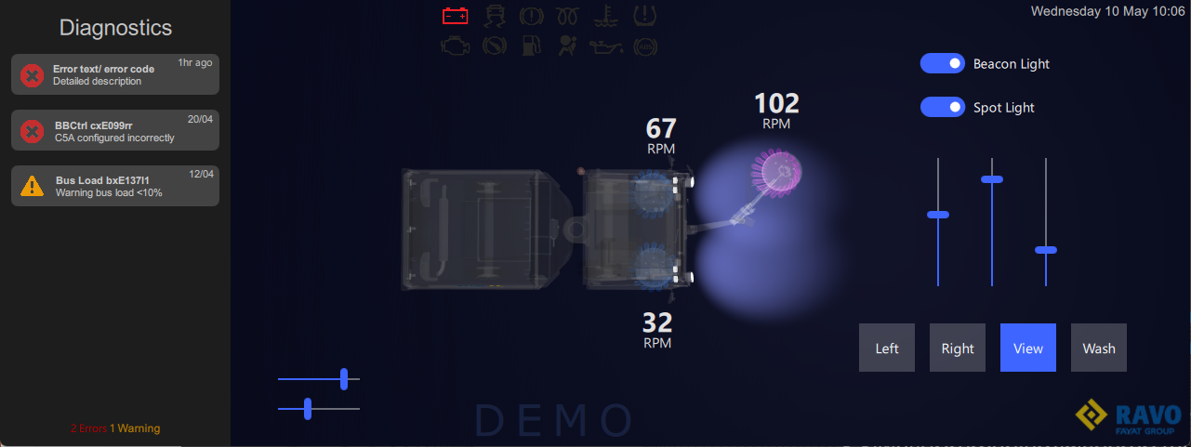
Group Development
Qt Front, CODESYS Back
Qt for the HMI (front-end) – modern, professional, intuitively designed
CODESYS 3.5 for the controller (back-end) – reliable, robust, no new development needed
Shared HMI development
A support network built up for Qt
A universal template and structure for development
Powerful Sales Tool
HMI’s represent the product and is how customers interact with our machines.
We need to let them feel like our machines are up-to-date with the latest tech.

Slide 31

Thank you!
Do you have any questions?
S.Siwasubramaniam@scarab.fayat.com

Slide 32
Credits.
Demo Developed on: Qt Design Studio
Project Supervisor : James Carter
Qt Account Manager: Szymon Moskal
Qt Technical Support: Erwan Coz
IFM Technical Support: John Hedges

Slide 33
